Slide 1
LINKED LIST Oswald c
The class notes are a compilation and edition from many sources from the materials of pioneers in Data Structures from CMU, HKUST, IIT KGP, U Texas, NorthWestern Univ.. The faculty does not claim intellectual property or ownership of the lecture notes. Thanks to them!

Slide 2
Doubly Linked List
A doubly linked list is a list that contains links to next and previous nodes
A node in a Doubly linked list has three fields namely:
Data Field – For holding the data
Forward link Field – For holding the address of next node
Backward link field – for holding the address of previous node
There exists two link between each node. (Forward and backward link for each node)
The first node is indicated using a head pointer and the last node is indicated using a last pointer.
The last nodes flink field is filled with NULL pointer to indicate the termination of linked list and the head nodes blink is filled with a NULL pointer to indicate the first node.
Traversal in a DLL is possible both direction(From head to last as well as from last to head).

Slide 3
Doubly Linked List – Node
Forward Address Field | Data Field | Backward Address Field
1. Data Field – For holding the data
2.Forward link Field – For holding the address of next node
3.Backward link field – for holding the address of prev node

Slide 4
Doubly Linked List - Representation
Null | 10 | 2000
1000 | 20 | 3000
2000 | 30 | Null
1000
2000
3000
head
Last

Slide 5
Declaration for DLL
typedef struct node
{
int data;
struct node *flink; // Forward Link field
struct node *blink; // Backward Link field
}*head=NULL,*newnode,*last,*delnode,*prev,*temp;
Node *head = (node*) malloc(sizeof(node));
The design of the node allows flexibility of storing any data type as the linked list data.

Slide 6
Doubly Linked List
To create a new node in a DLL we can define two basic functions
getnode( ) – for allocating the memory for a node dynamically.
readnode( )- for reading data and assigning a NULL value in link field.
Whenever we need to create a new node we can call the functions getnode( ) and readnode( ).

Slide 7
Creating a new node
getnode()
{
newnode=(node*)malloc(sizeof(node));
}
readnode()
{
Read newnode->data;
newnode->flink=NULL;
newnode->blink=NULL;
}

Slide 8
Creating a DLL
create()
{
int c;
if(head!=NULL)
{
print”Linked List is already created“;
return(0);
}
else
{
do
{
getnode();
readnode();
if(head==NULL)
{
head=last=newnode;
}
else
{
last->flink=newnode;
newnode->blink=last;
last=last->flink;
}
print”Press 1 to add another node:”;
read c;
} while(c==1);
}
return(0);
}

Slide 9
Creating Doubly Linked List
Null | 10 | 2000
1000 | 20 | 3000
2000 | 30 | Null
1000
2000
3000
head
Last

Slide 10
Insert Last in DLL
Before Insertion
Null | 10 | 2000
1000 | 20 | NULL
1000
2000
head
Last
After Insertion
Null | 10 | 2000
1000 | 20 | 3000
2000 | 30 | Null
1000
2000
3000
head
Last

Slide 11
Insert Last in DLL
insertlast()
{
getnode();
if(newnode==NULL)
{
printf"No Memory";
return(0);
}
readnode();
if(head==NULL)
{
head=last=newnode;
return(0);
}
last->flink=newnode;
newnode->blink=last;
last=last->flink (or) newnode;
}

Slide 12
Insert First in DLL
Before Insertion
Null | 10 | 2000
1000 | 20 | NULL
1000
2000
head
Last
After Insertion
NULL | 30 | 1000
3000 | 10 | 2000
1000 | 20 | 3000
3000
1000
2000
head
Last

Slide 13
Insert First in DLL
int insertfirst()
{
getnode();
if(newnode==NULL)
{
print”No Memory";
return(0);
}
readnode();
if(head==NULL)
{
head=last=newnode;
return(0);
}
newnode->flink=head;
head->blink=newnode;
head=newnode;
}

Slide 14
Insert Middle in DLL
Before Insertion
Null | 10 | 2000
1000 | 20 | 3000
2000 | 30 | Null
1000
2000
3000
head
Last
After Insertion – Where x=20
Null | 10 | 2000
1000 | 20 | 4000
4000 | 30 | Null
1000
2000
3000
head
temp
next
Last
2000 | 50 | 3000
4000
newnode

Slide 15
Insert Middle in DLL
int insertmiddle()
{
int x;
getnode();
if(newnode==NULL)
{
print “No Memory“;
return(0);
}
readnode();
if(head==NULL)
{
head=last=newnode;
return(0);
}
print”Enter the node after which you want to insert the new node:";
read x;
temp=head;
while(temp!=NULL)
{
if(temp->data==x)
{
next=temp->flink;
newnode->flink=next;
next->blink=newnode;
temp->flink=newnode;
newnode->blink=temp;
return(0);
}
else
temp=temp->flink;
}
return(0);
}

Slide 16
Delete First in DLL
Before Deletion
Null | 10 | 2000
1000 | 20 | 3000
2000 | 30 | Null
1000
2000
3000
Last
head
After Deletion
NULL | 20 | 3000
2000 | 30 | Null
2000
3000
Deleted Node
head
Last
Null | 10 | 2000

Slide 17
Delete First in DLL
delfirst()
{
if(head==NULL)
{
print”SLL is empty:";
return(0);
}
else if(head==last)
{
delnode=head;
print "Deleted node is delnode->data;
head=last=NULL;
free(delnode);
return(0);
}
else
{
delnode=head;
print "Deleted node is delnode->data;
head=head->flink;
free(delnode);
return(0);
}
}

Slide 18
Delete Last in DLL
Before Deletion
Null | 10 | 2000
1000 | 20 | 3000
2000 | 30 | Null
1000
2000
3000
Last
After Deletion
NULL | 10 | 2000
1000 | 20 | Null
1000
2000
head
Last
Deleted Node
2000 | 30 | Null

Slide 19
Delete Last in DLL
int dellast()
{
if(head==NULL)
{
printf("\nSLL is empty:");
return(0);
}
else if(head==last)
{
delnode=head;
printf("\nDeleted node is %d",delnode->data);
head=last=NULL;
free(delnode);
return(0);
}
else
{
delnode=last;
printf("\nDeleted node is %d",delnode->data);
last=last->blink;
last->flink=NULL;
free(delnode);
return(0);
}
}

Slide 20
Delete Middle in DLL
Before Deletion
Null | 10 | 2000
1000 | 20 | 3000
2000 | 30 | 4000
3000 | 40 | NULL
1000
2000
3000
4000
head
Last
After Deletion – Where X = 30
Null | 10 | 2000
1000 | 20 | 4000
2000 | 40 | NULL
1000
2000
4000
head
Last
Deleted Node
2000 | 30 | 4000
Delnode

Slide 21
Delete Middle in DLL
int delmiddle()
{
int x;
if(head==NULL)
{
printf("\nSLL is empty:");
return(0);
}
else if(head==last)
{
delnode=head;
print”Deleted node is delnode->data;
head=last=NULL;
free(delnode);
return(0);
}
else
{
temp=head;
print"Enter the element which has to be deleted";
read x;
while(temp!=NULL)
{
if(temp->data==x)
{
delnode=temp;
next=temp->flink;
prev=temp->blink;
prev->flink=next;
next->blink=prev;
print”Node deleted is delnode->data;
free(delnode);
return(0);
}
else
{
temp=temp->flink;
}
}
}
}

Slide 22
Traversal and display
display() // Forward Traversal
temp=head
{
if(head==NULL)
{
printf("\DLL is Empty");
return(0);
}
temp=head;
while(temp!=NULL)
{
print temp->data;
temp=temp->flink;
}
}
display() // Backward Traversal
{
if(head==NULL)
{
printf("\nSLL is Empty");
return(0);
}
temp=last;
while(temp!=NULL)
{
print temp->data;
temp=temp->blink;
}
}
Traversal:
Both forward and backward traversal is possible in a Doubly linked list.

Slide 23
DLLs compared to SLLs
Advantages:
Can be traversed in either direction (may be essential for some programs)
Some operations, such as deletion and inserting before a node, become easier
Disadvantages:
Requires more space
List manipulations are slower (because more links must be changed)
Greater chance of having bugs (because more links must be manipulated)

Slide 24
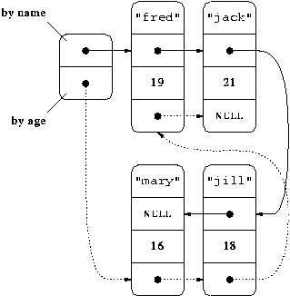
Multi Linked List - An Example

Slide 25
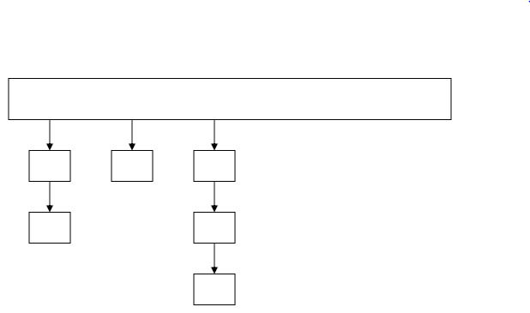
An Array of Linked Lists
An array of linked list is an interesting structure as it combines a static structure (an array) and a dynamic structure (linked lists) to form a useful data structure.

Slide 26
The End
I had written a starfield screensaver, much like many other screensavers of the time, and it was running on my Mac. A co-worker walked by and saw the screensaver, and he asked me, “Is that a real program, or is that something somebody wrote?” The Evolution of a Programmer http://lists.canonical.org/pipermail/kragen-tol/2007-March/000849.html

